Slide 1

3DHB ICT Cloud Framework
January 2018

Slide 2
Background
A “cloud” service is any service made available to DHB users via the Internet from an external provider's computing services. Some cloud services we are already using at 3DHB are:
SmartPage Hospital Messaging
McKesson Capacity Planner
SaferSleep Anaesthesia Management
Volpara Breast Imaging Analytics
Use of “cloud” services is accelerating dramatically
A number of DHB services are already using them
We expect that every DHB service will have approached ICT for assistance with a cloud based service before too long
The providers of the “cloud” services usually assure us their “cloud” service is “secure” but often it’s hard to be sure what they mean by “secure”.
2

Slide 3

Are there any rules?
“The government tells us that we should prefer Cloud services BUT all Cloud services hosted off-shore must be signed off by your CEO...”
How does that work when just about every cloud service is off-shore?
“Be it therefore enacted by the Queen's most Excellent Majesty...one of such Persons, while any Locomotive is in Motion, shall precede such Locomotive on Foot by not less than Sixty Yards, and shall carry a Red Flag constantly displayed, and shall warn the Riders and Drivers of Horses of the Approach of such Locomotives...”
- The Locomotive Act 1865 (Red Flag Act)
“Be it therefore enacted by the Queen's most Excellent Majesty...one of such Persons, while any Locomotive is in Motion, shall precede such Locomotive on Foot by not less than Sixty Yards, and shall carry a Red Flag constantly displayed, and shall warn the Riders and Drivers of Horses of the Approach of such Locomotives...”
- The Locomotive Act 1865 (Red Flag Act)

Slide 4
We sought some clarification
DIA – “We want some assurance that someone has considered the risks and taken responsibility for managing them. The CEO can delegate this responsibility”
MoH – “We expect an assessment that is proportionate to the level of risk. There must be some objective oversight in the process”

Slide 5
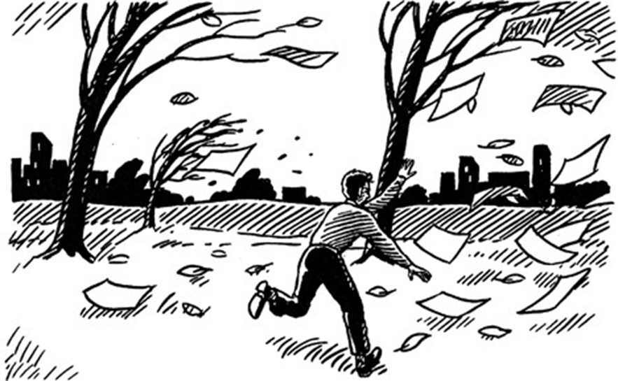
It’s about risk...
Confidential patient information escaping onto the internet is just one risk
"The Framework includes tools to enable busy staff to self-manage the risk assessment process where common-sense coupled with some guidance are sufficient to manage the risk”

Slide 6
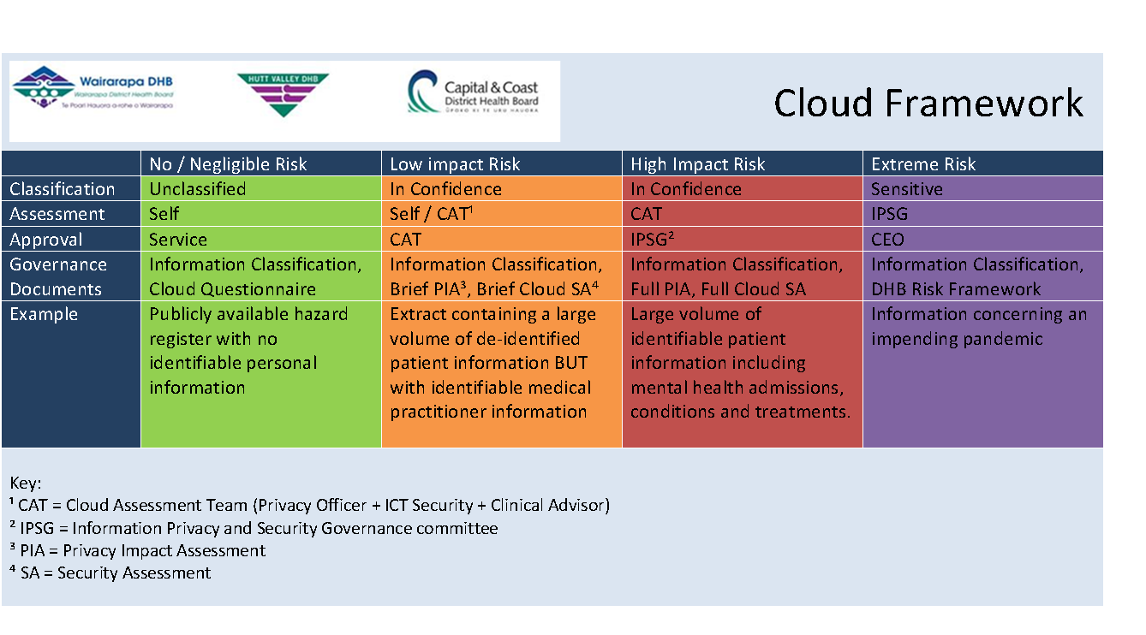
The Framework Risk Management

Slide 7
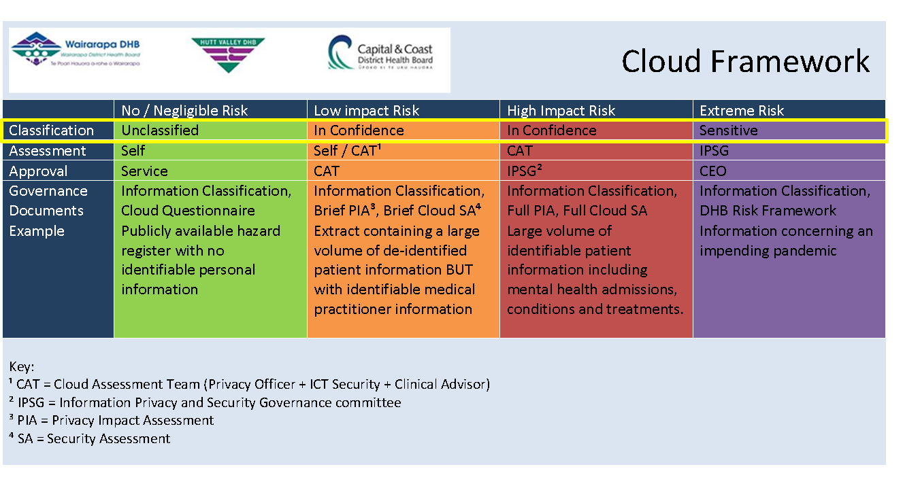
The Framework Risk and Information Classification are directly related

Slide 8
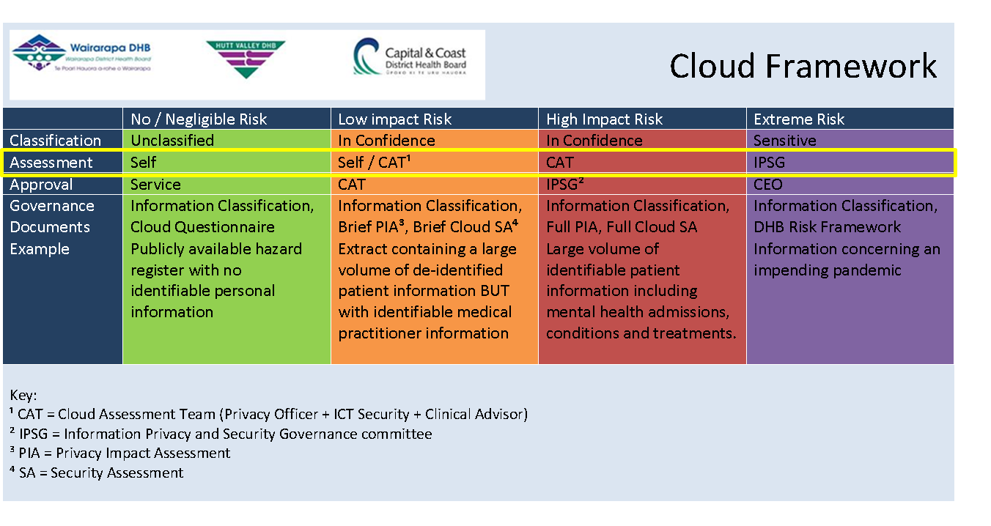
The Framework Where the risk is negligible, the business can assess the impact. As the risk increases, specialists become involved in the assessment process.

Slide 9

The Framework Where the risk is negligible, the business can approve the service. As the risk increases, the approval process becomes more formal and must be supported with evidence.

Slide 10

The Framework Where the risk is negligible, the business can complete the governance documents. As the risk increases, the governance documents are prepared by specialists.

Slide 11
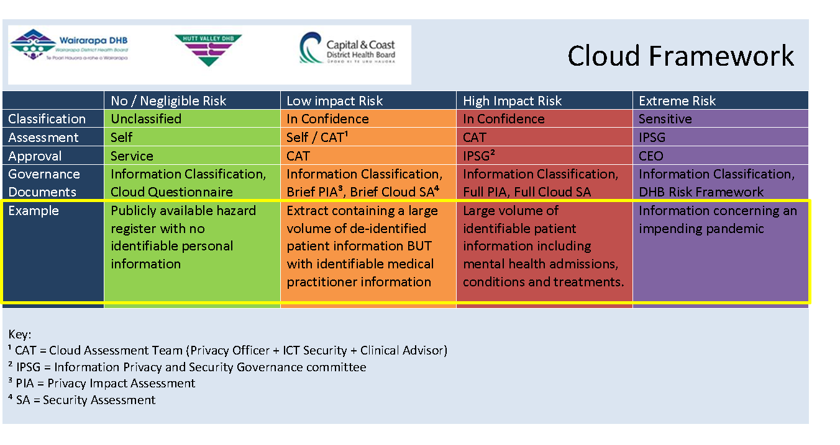
The Framework Below are some examples of information and the degree of risk associated with them

Slide 12
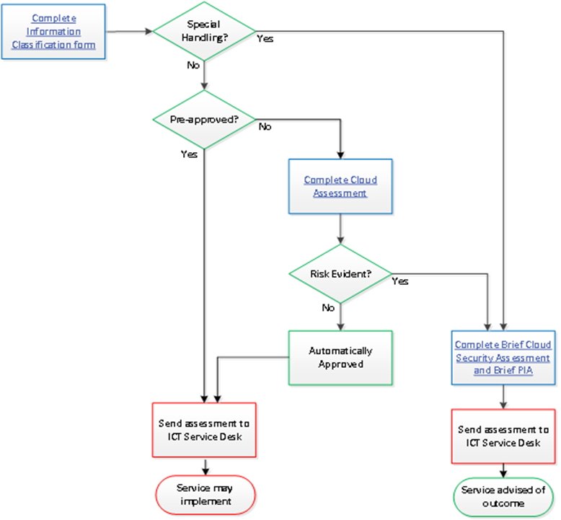
How do I use it? A document is required where you see a container with blue writing. You will be told if you need to furnish more documentation – i.e. if risk becomes apparent. A register of all Cloud Service assessments is maintained by the ICT Service Desk

Slide 13
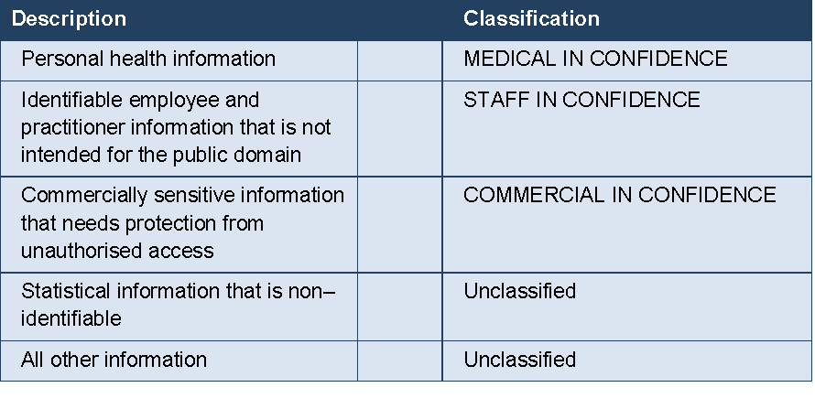
Step 1 Classify your information
Spoiler alert: Does your information contain sensitive matter that requires special handling e.g. Identifiable patient information concerning Mental Health, Sexual Health, Domestic Violence or the ACC Special Claims unit?

Slide 14
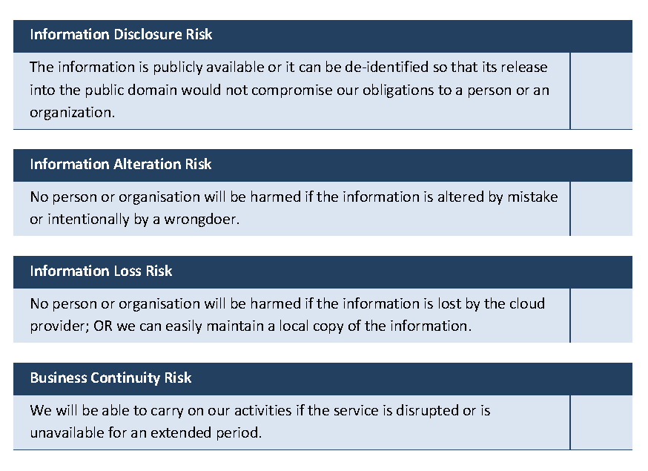
Step 2 Do a base risk assessment
“These statements are not asking you how good the vendor thinks their system is. They are asking you to think honestly about what would happen if something goes wrong.”

Slide 15
Step 3 Notify the ICT Service Desk
If your proposal is genuinely negligible risk, the ICT Service Desk will automatically notify DIA and MoH on you behalf.
This serves two purposes:
Lets DIA and MoH know that we are actively managing risk
Enables our assessment to be shared with other agencies so that assessments are not repeated unnecessarily
You are free to enjoy your new cloud service!

Slide 16

It turns out my proposal has more risk than I thought...
The ICT Service Desk will direct the proposal to the appropriate specialists who will work with you to see if there are ways to manage the risk such as de-identifying your data or providing a back up capability. ICT will keep a register of Cloud services used across 3DHB.

